Slide 1
LED Programming Workshop

Slide 2
Agenda
Demo of prototype (without costume)
Basic Wiring Diagram
Basic Programming
Lighting up single / multiple LEDs
LED Color Effects
Download and install software

Slide 3
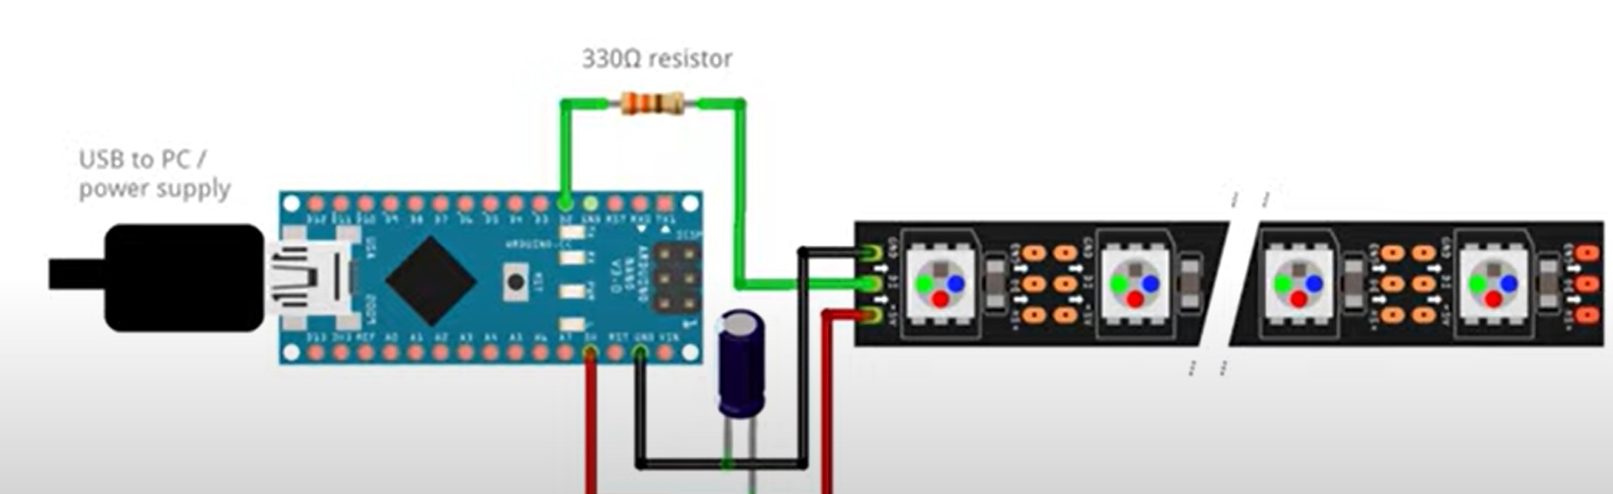
Basic Wiring Diagram
Data input
0
1
2
3
LED Strip
Data output
Arduino Chip
Power Source (Battery / Laptop (feeds program to chip))

Slide 4
Basic Programming – Variables and Data Types
Variable – Just like what we learnt in algebra, a variable is something that can take a value, and its value can change over time
Data type – This defines what type of value a variable can hold
Eg:
Integer – int
Decimal – float
Constants – A special variable whose value does not change over time
int x = 10 (x is a variable that can hold only integer values)
float y = 4.2 (y is a variable that can hold only decimal values)
const float pi = 3.14 (pi is a constant variable whose value is set to 3.14)

Slide 5
Basic Programming – Arrays
Array – A variable that can hold a list of values of the same data type
Array Declaration
<data type> <variable name>[<number of values>]
Eg: int num[10] (num is an array variable that can hold 10 integer values)
Note: Array index starts from 0
Array Assignment
num[0] = 5;
num[1] = 2;
num[9] = 7;
num[10] = 2 -> Error: cannot be assigned

Slide 6
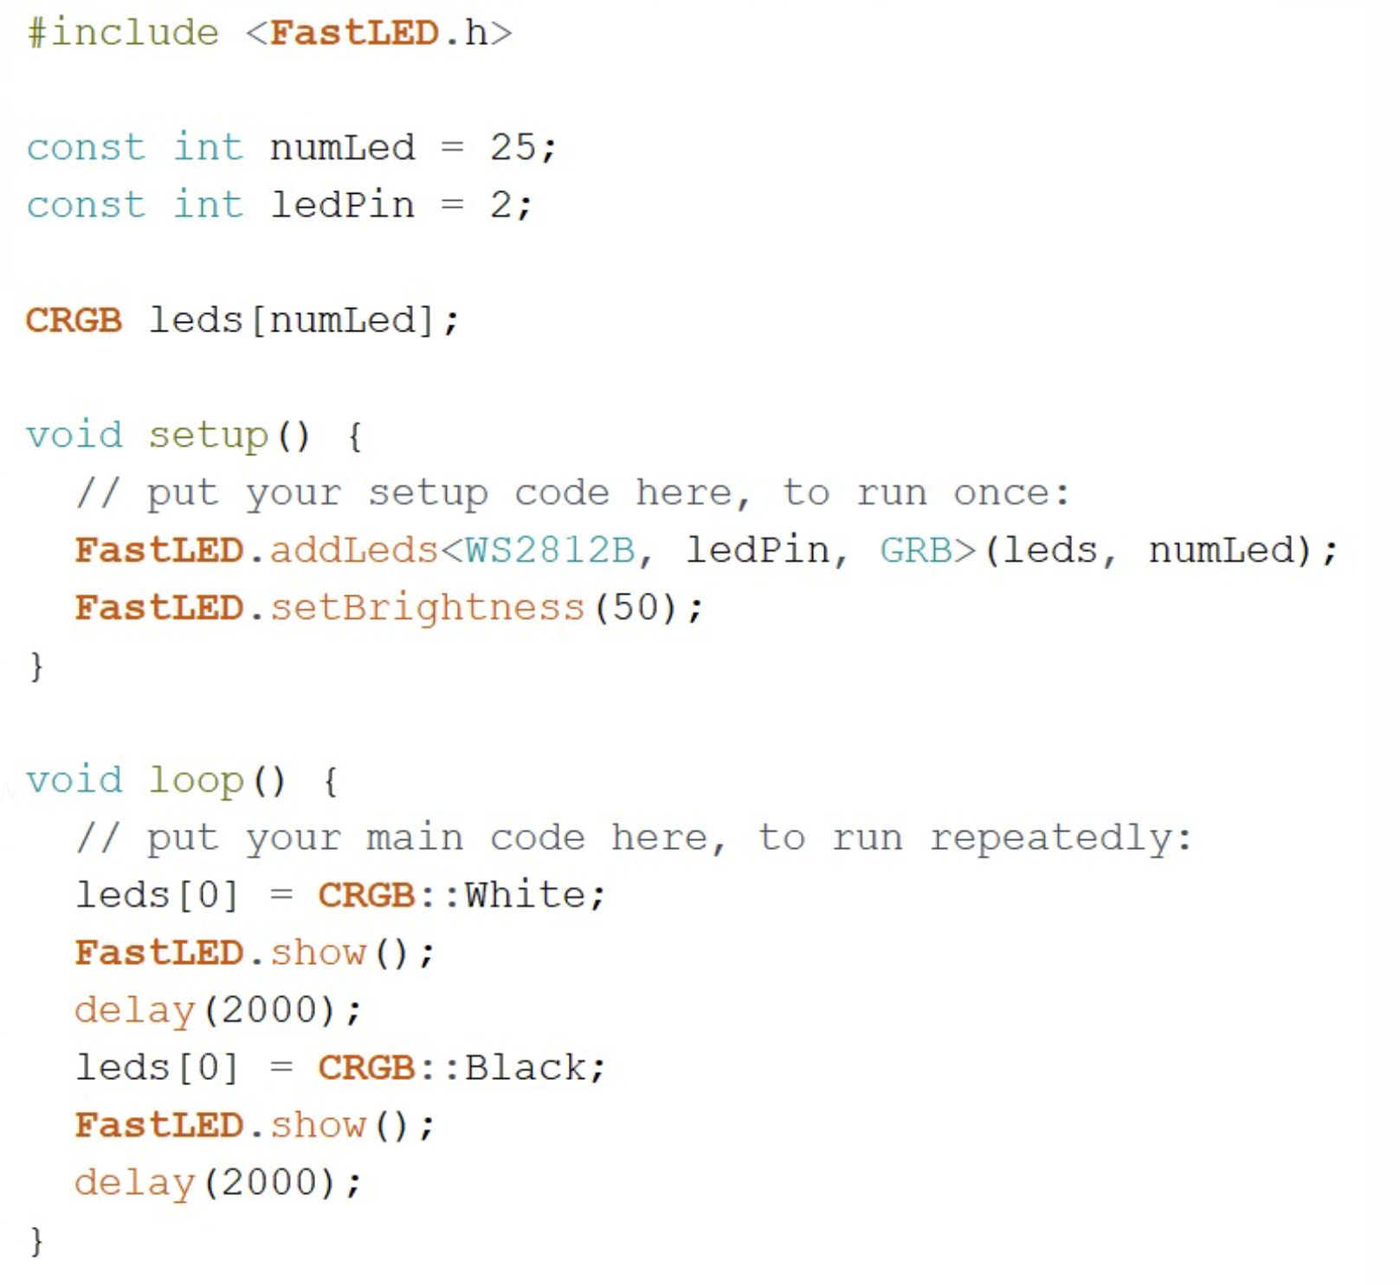
Lighting up a single LED

Slide 7
Basic Programming: Looping constructs
Basic loop definition: Perform an action until a certain condition is met
For loop
for(<initialize a variable> <condition is true><change variable>) {
<do something>
}
Eg: for(int i=0; i<10;i++) {
print(i);
}
Output: 0 1 2 3 4 5 6 7 8 9
While loop
while(<condition is true>)
<do something>
}
Eg: i=0;
while(i < 10) {
print(i);
i++;
}
Output: 0 1 2 3 4 5 6 7 8 9

Slide 8
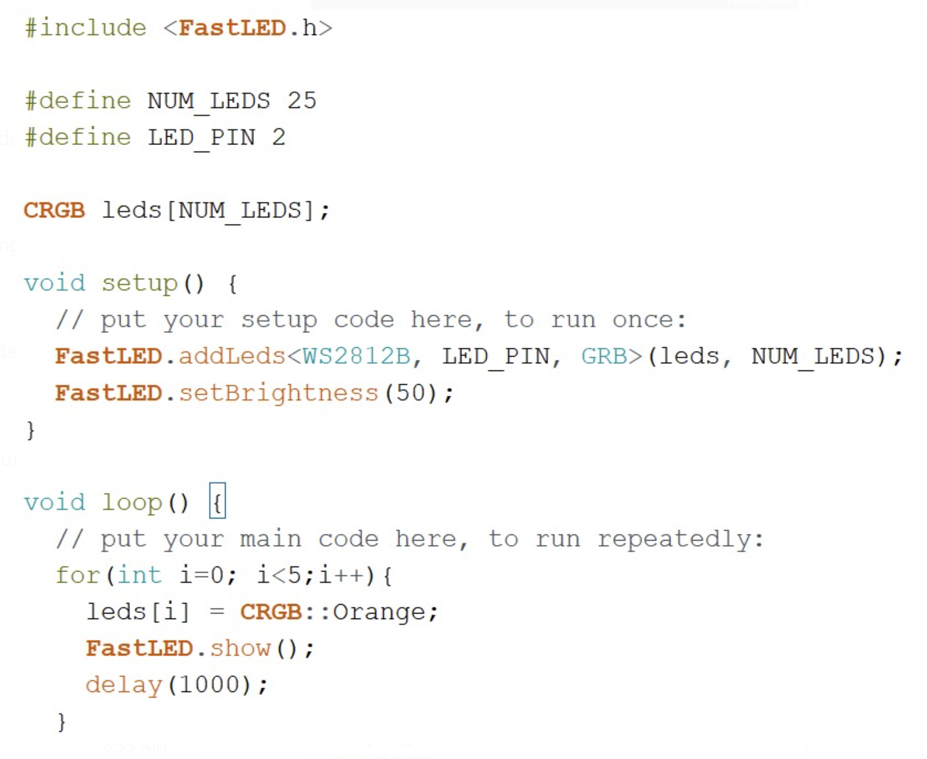
Lighting up multiple LEDs (using for loop)

Slide 9
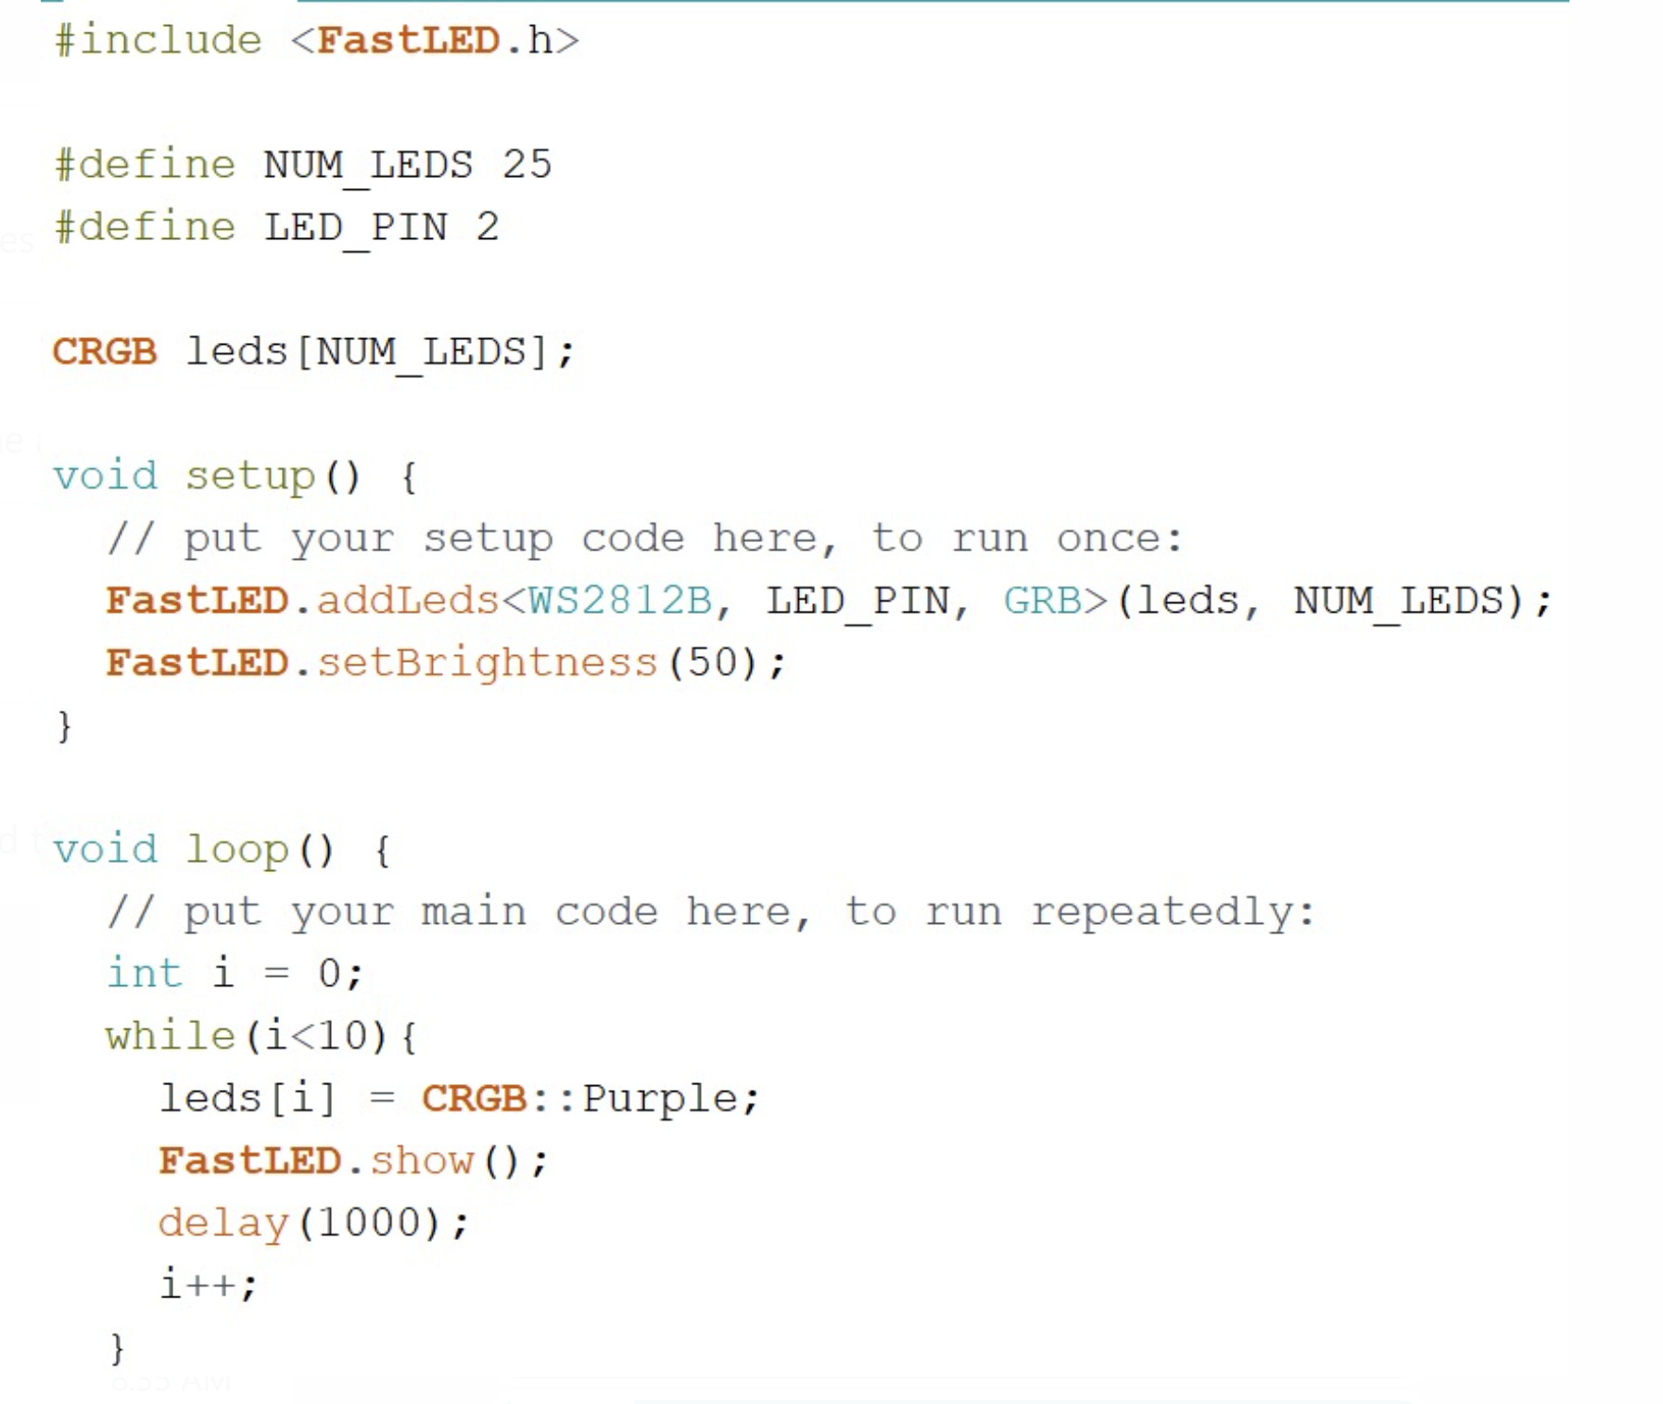
Lighting up multiple LEDs (using while loop)

Slide 10
LED Lighting Effects
Rainbow Effect – All LEDs dynamically change colors in the order of the rainbow
Throb Effect – Half the LEDs light up, then all LEDs light up, then all LEDs go off
Gradient Effect – LEDs are statically lit from one color to another color
Flash Effect – All LEDs are set to a specific color for a brief period of time

Slide 11
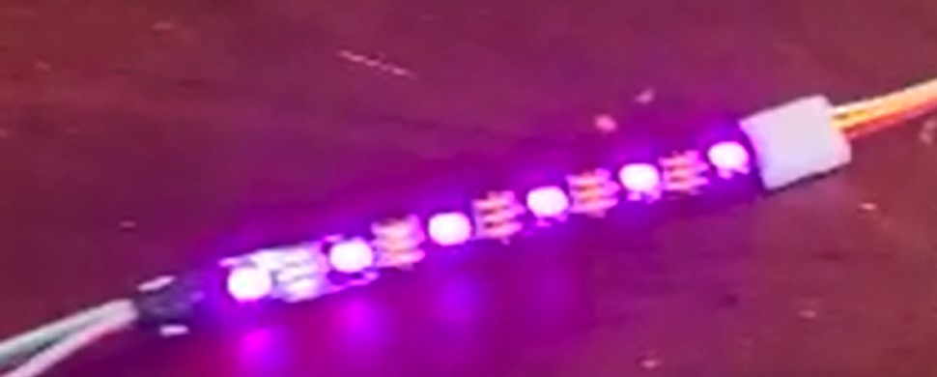
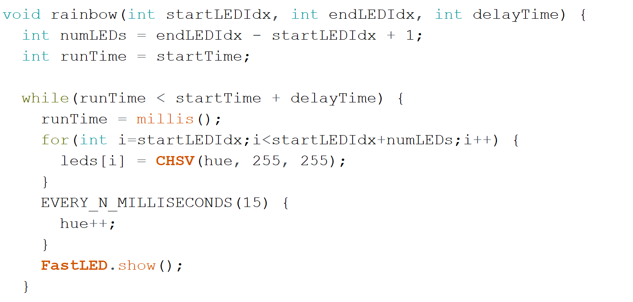
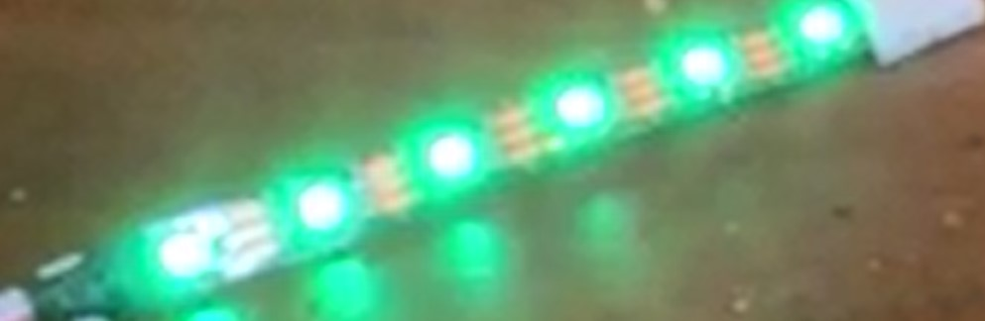
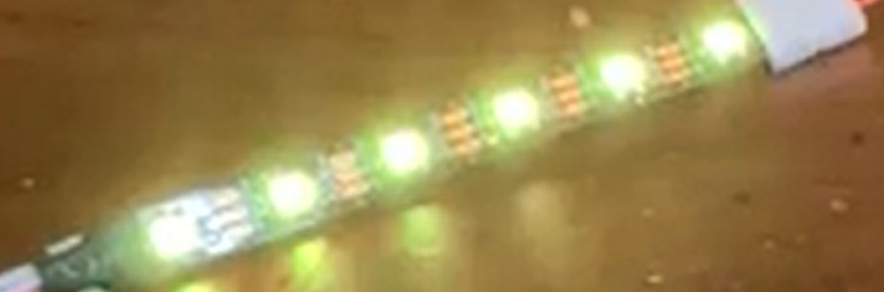
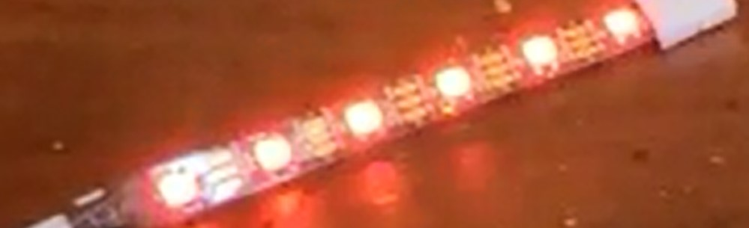
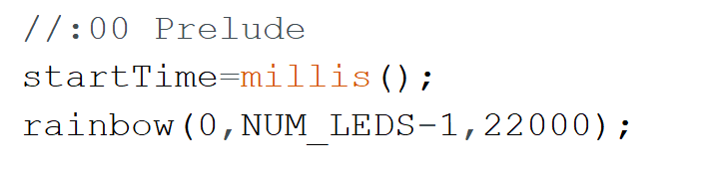

Rainbow Effect
Sample Usage

Slide 12
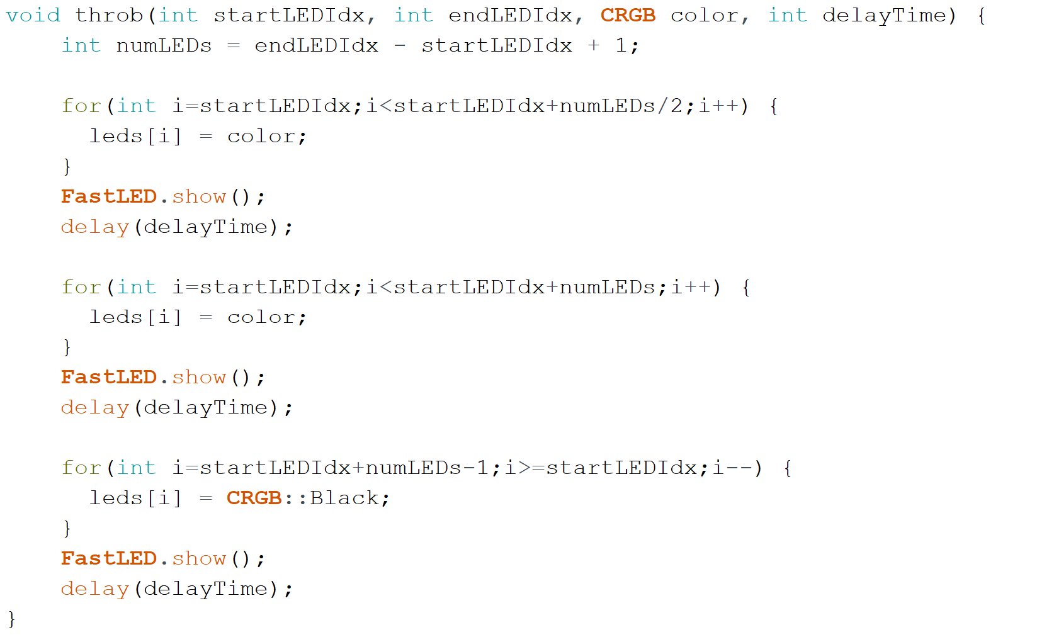
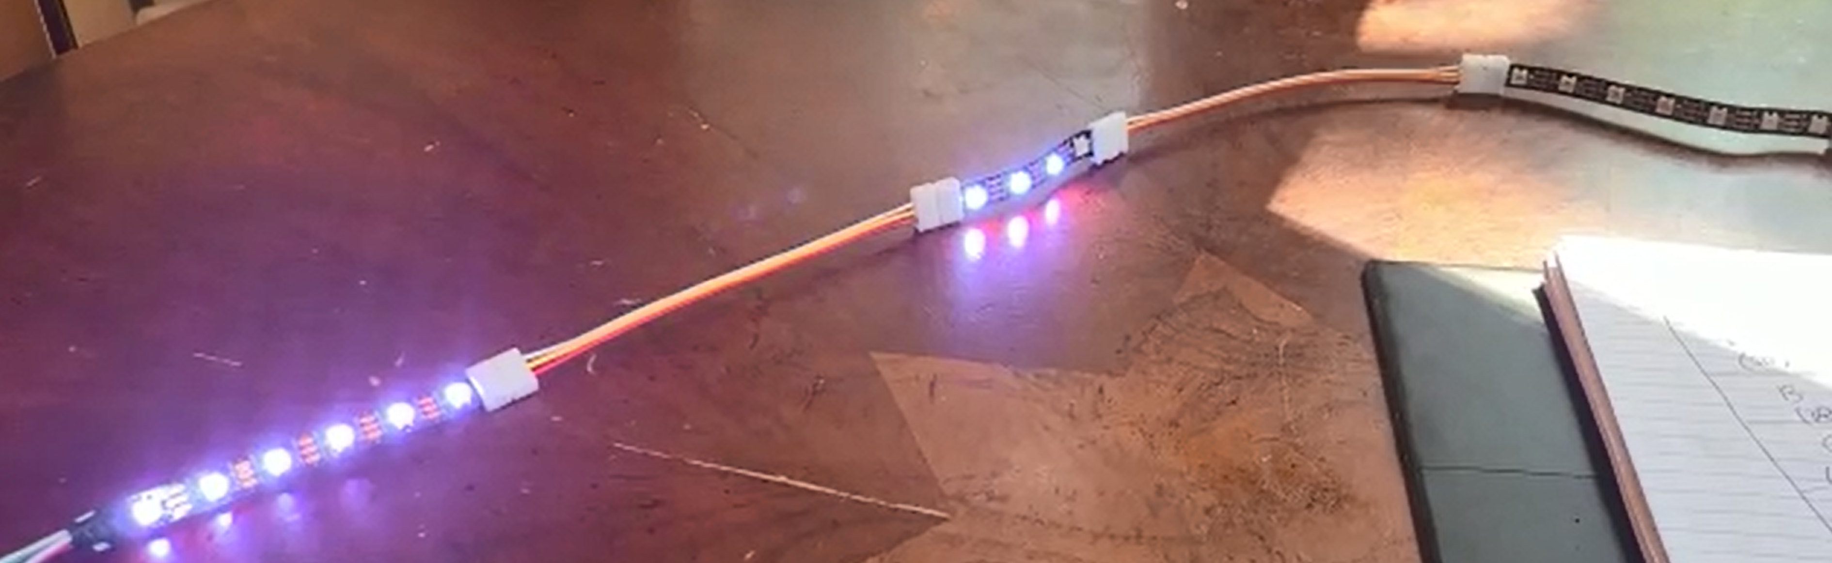
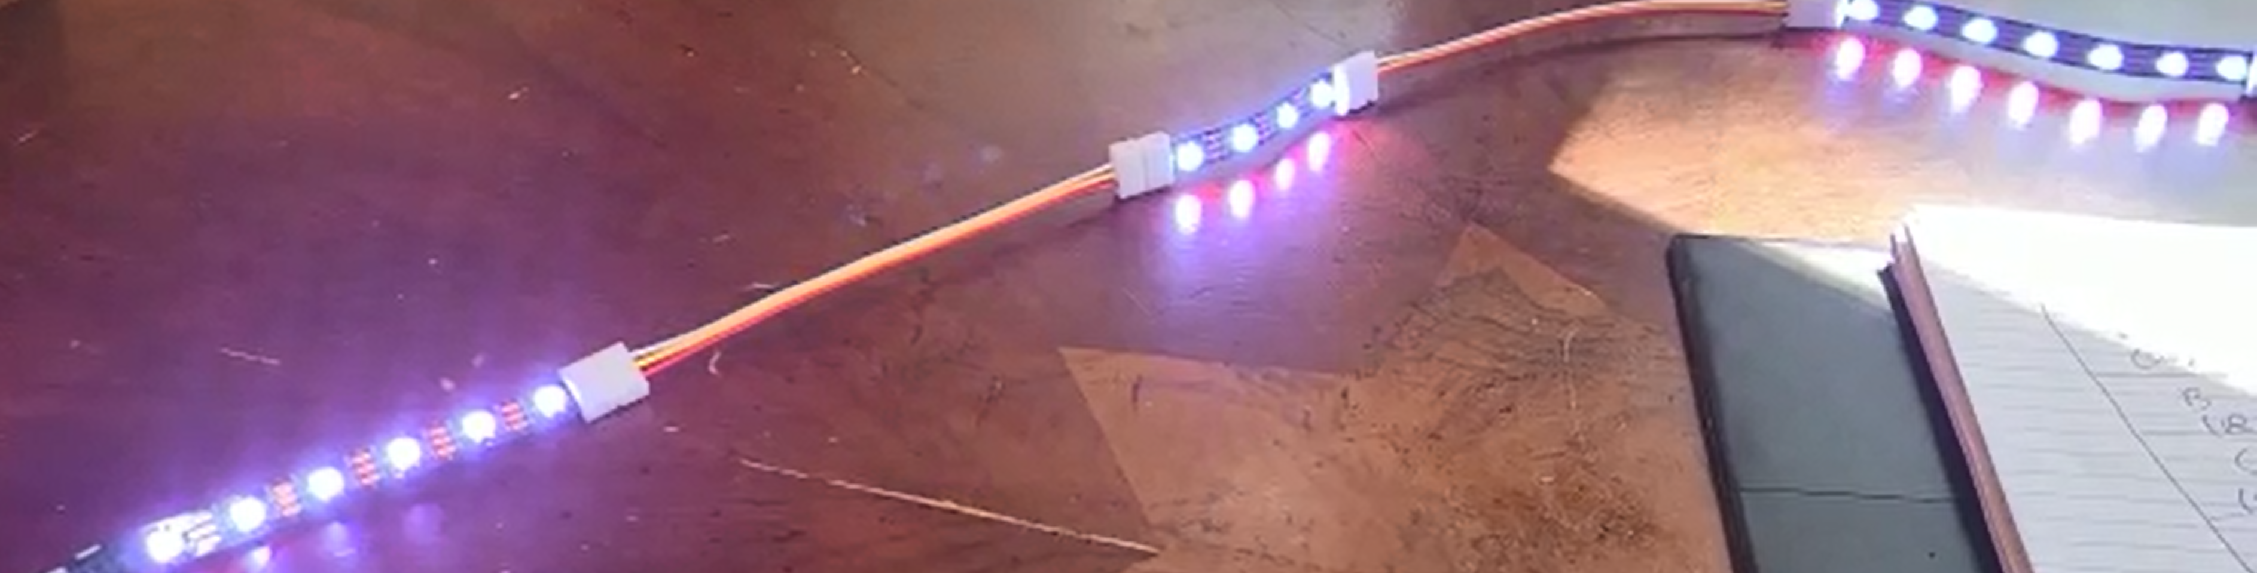
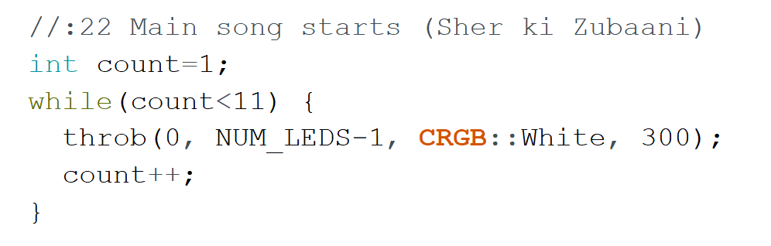
Throb Effect
Sample Usage

Slide 13
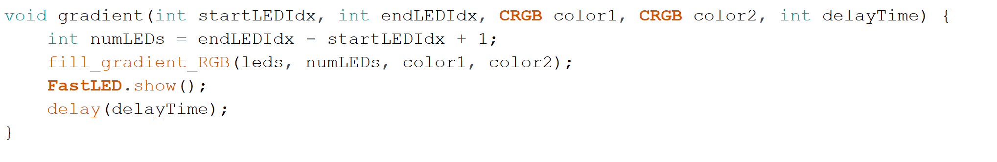
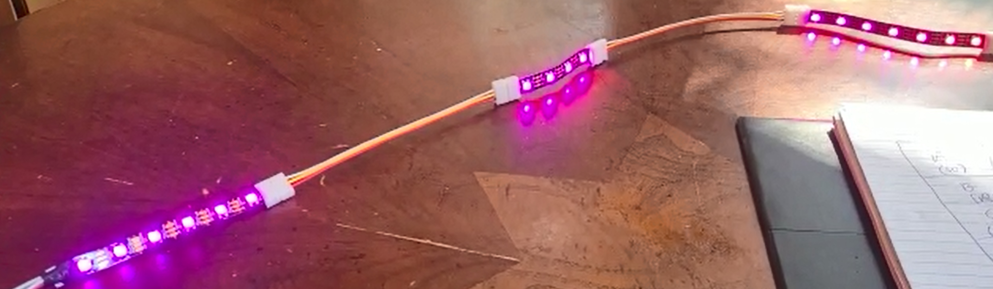
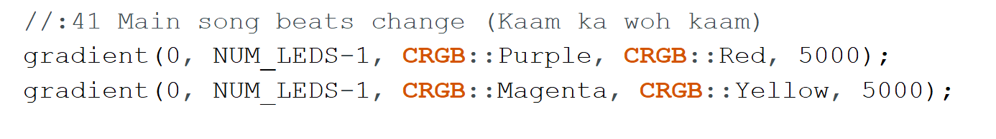
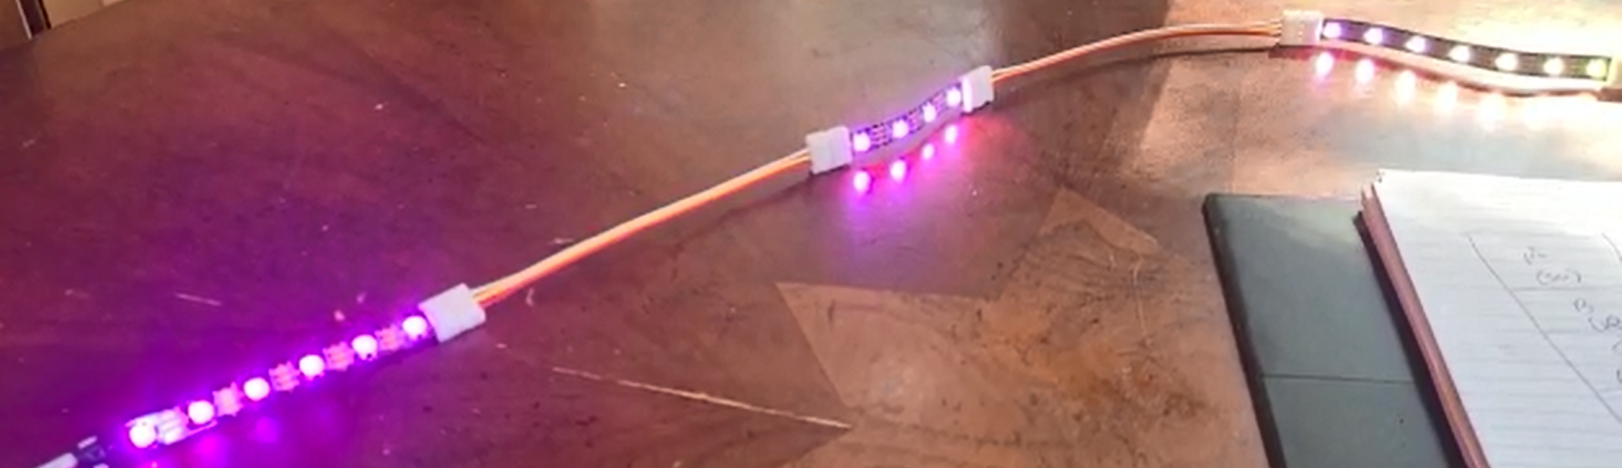
Gradient Effect
Sample Usage

Slide 14
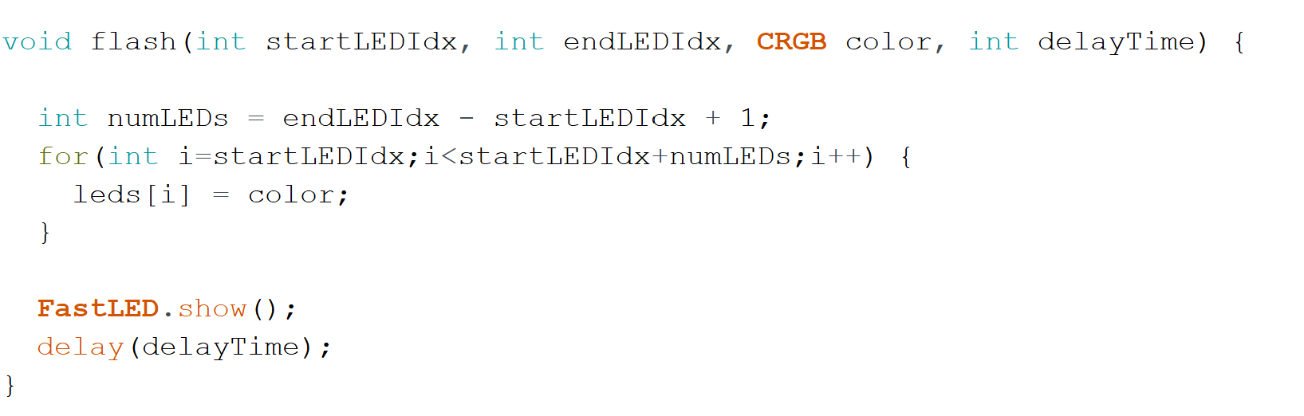
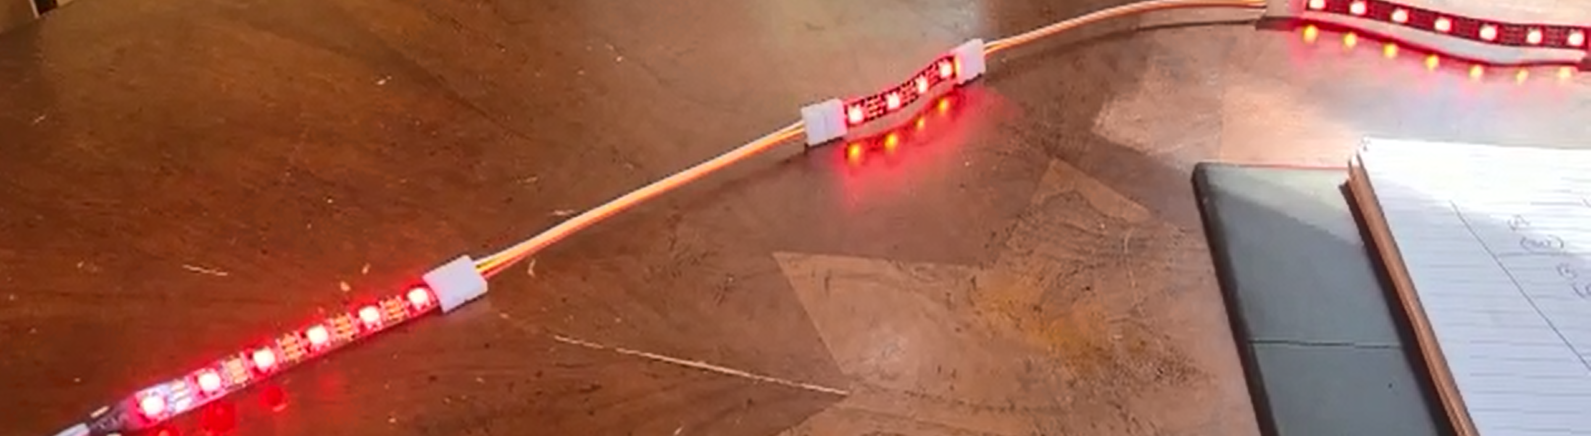
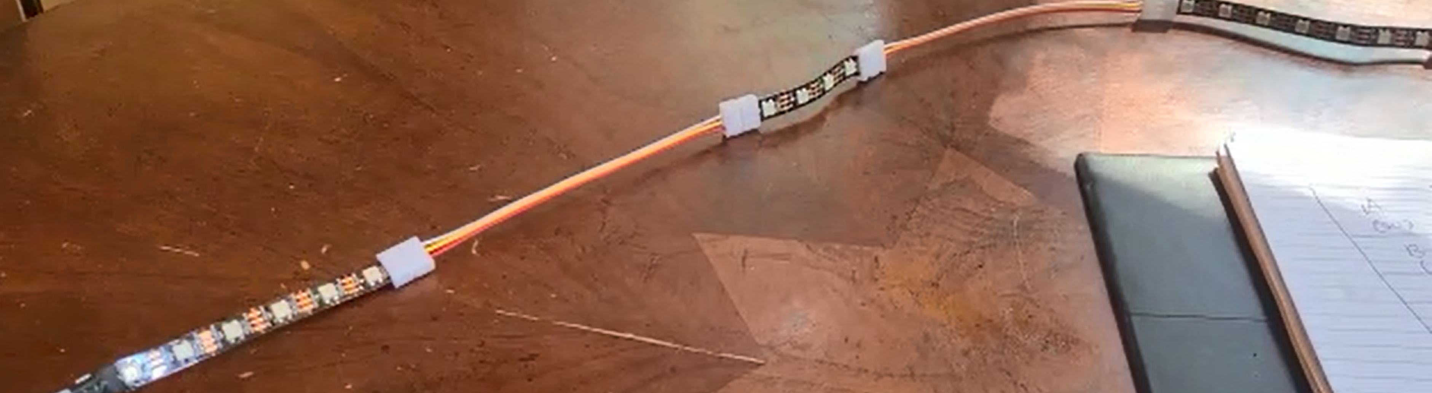
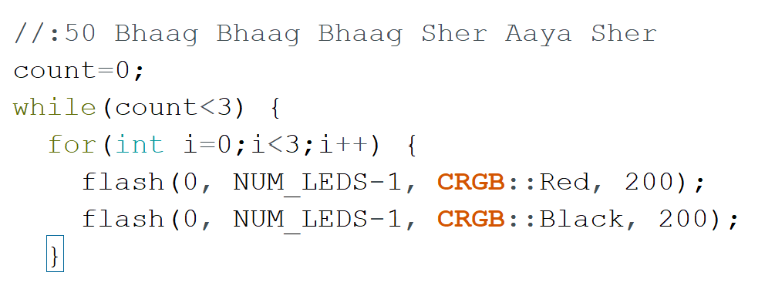
Flash Effect
Sample Usage

Slide 15
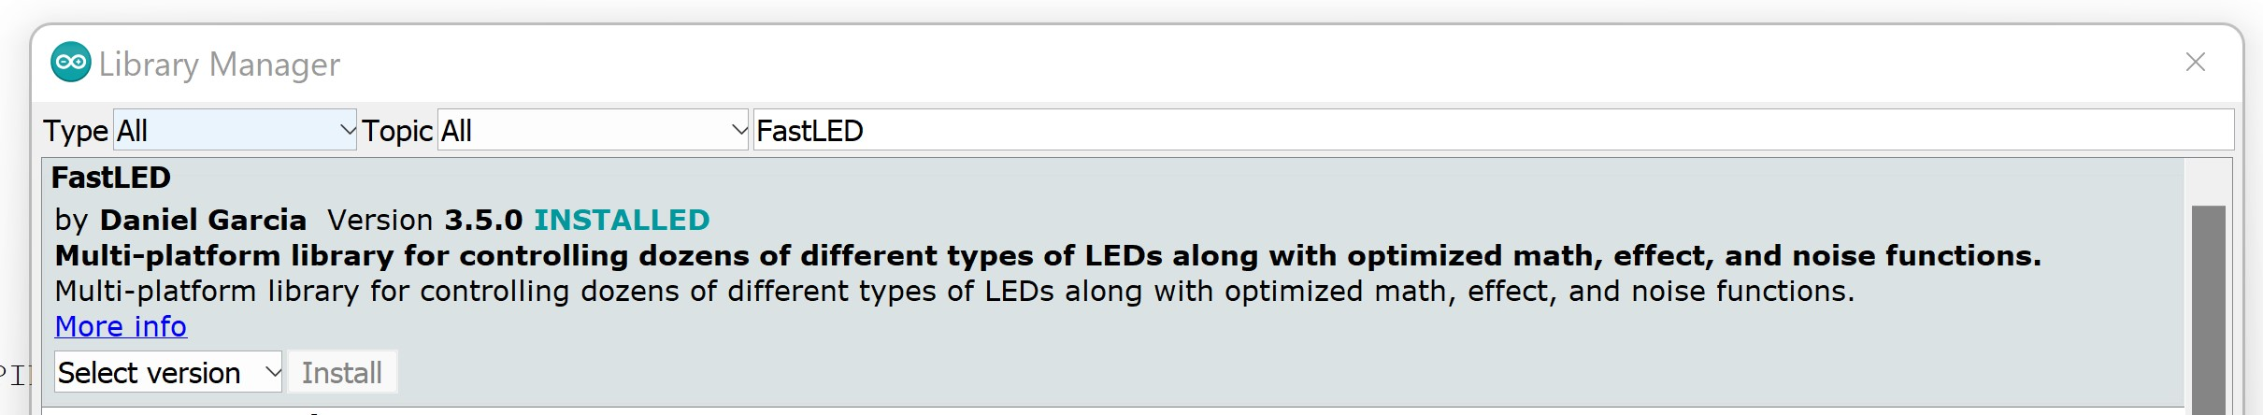
Steps to install Arduino
Download Software | Arduino (Steps are in link#1 below)
Install FastLED library (Steps are in link#4 below)
After installing Arduino, go to Tools > Manage Libraries
Recommended Videos
Arduino Tutorial 1: Setting Up and Programming the Arduino for Absolute Beginners
Arduino Tutorial 2: Understanding How Light Emitting Diodes (LEDs) Work
Arduino Tutorial 3: Understanding How Breadboards Work
FastLED Basics Episode 1 - Getting started - YouTube
FastLED Basics Episode 2 - Color: RGB and HSV - YouTube

